Slide 1
2211cs010188
S2-28
Mini Project on Employees Office Data
Dataset : OfficeDataProject.csv
Source :https://www.data.gov.in/resource/wholesale-price-index-base-year-2011-12-upto-may-2017

Slide 2
Dataset Summary: WPI (Wholesale Price Index) 2011–2017
Dataset Overview
Name: WPI-2011-12-May2017.csv
Shape: 869 rows × 76 columns
Period Covered: April 2011 – May 2017 (74 months)
Purpose: Measures inflation trends in wholesale markets in India.
Columns
COMMODITIES
Name of commodity or group (e.g., All Commodities, Primary Articles, Wheat, Paddy, Jowar).
Includes aggregate groups (like "All Commodities") and detailed items (like "Paddy").
Weight
Relative importance in the overall WPI basket.
For example:
All Commodities = 100
Primary Articles = 22.6
Sub-items like Paddy, Wheat, Bajra have smaller weights.
Monthly Columns (Apr-11 … May-17)
Index values for each month.
Base year = 2011–12 (WPI = 100 in that year).
Example:
Apr-11: 97.1 (slightly below base year)
May-17: 112.8 (price increase since 2011).

Slide 3
Inflation Trend:
WPI (All Commodities) grew from 97.1 (Apr-2011) to 112.8 (May-2017) (~16% growth).
Food Inflation:
Food Articles rose from 94.1 → 137.7 (~46% growth), showing stronger inflation.
Cereal Example:
Paddy: 97.5 → 147.9 (~52% growth).
Wheat: 101.1 → 137.5 (~36% growth).
Volatility:
Commodities like Jowar, Bajra show large fluctuations (seasonal effects).
Weights:
Higher weights (e.g., Primary Articles, Fuel, Manufacturing) drive the overall WPI.
Smaller items contribute less individually but show interesting trends.

Slide 4
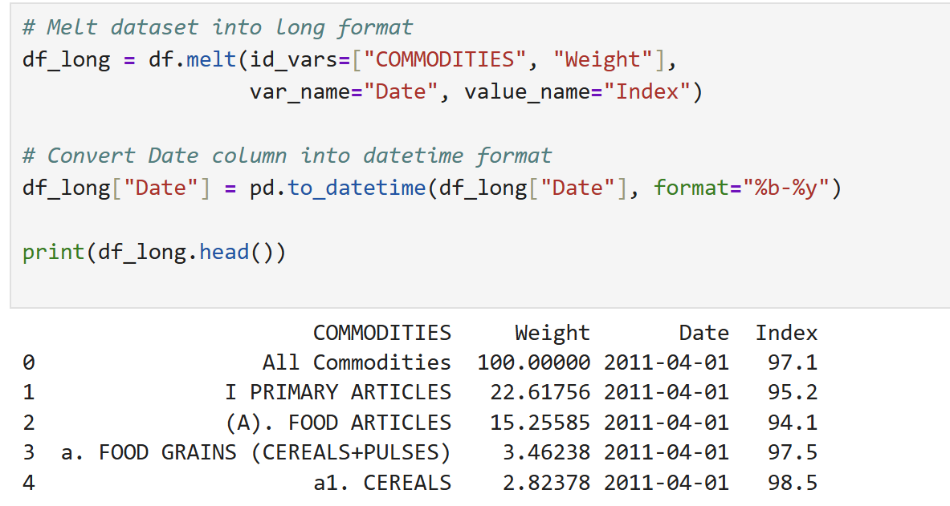

Slide 5
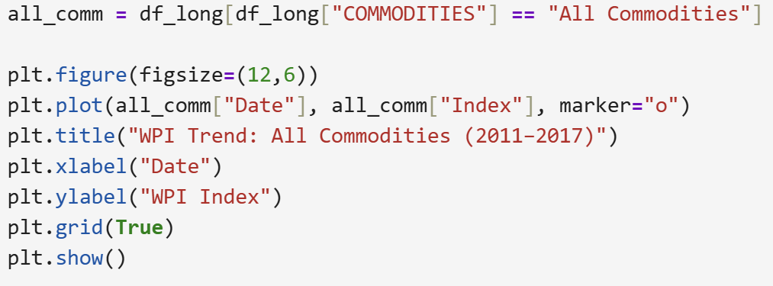
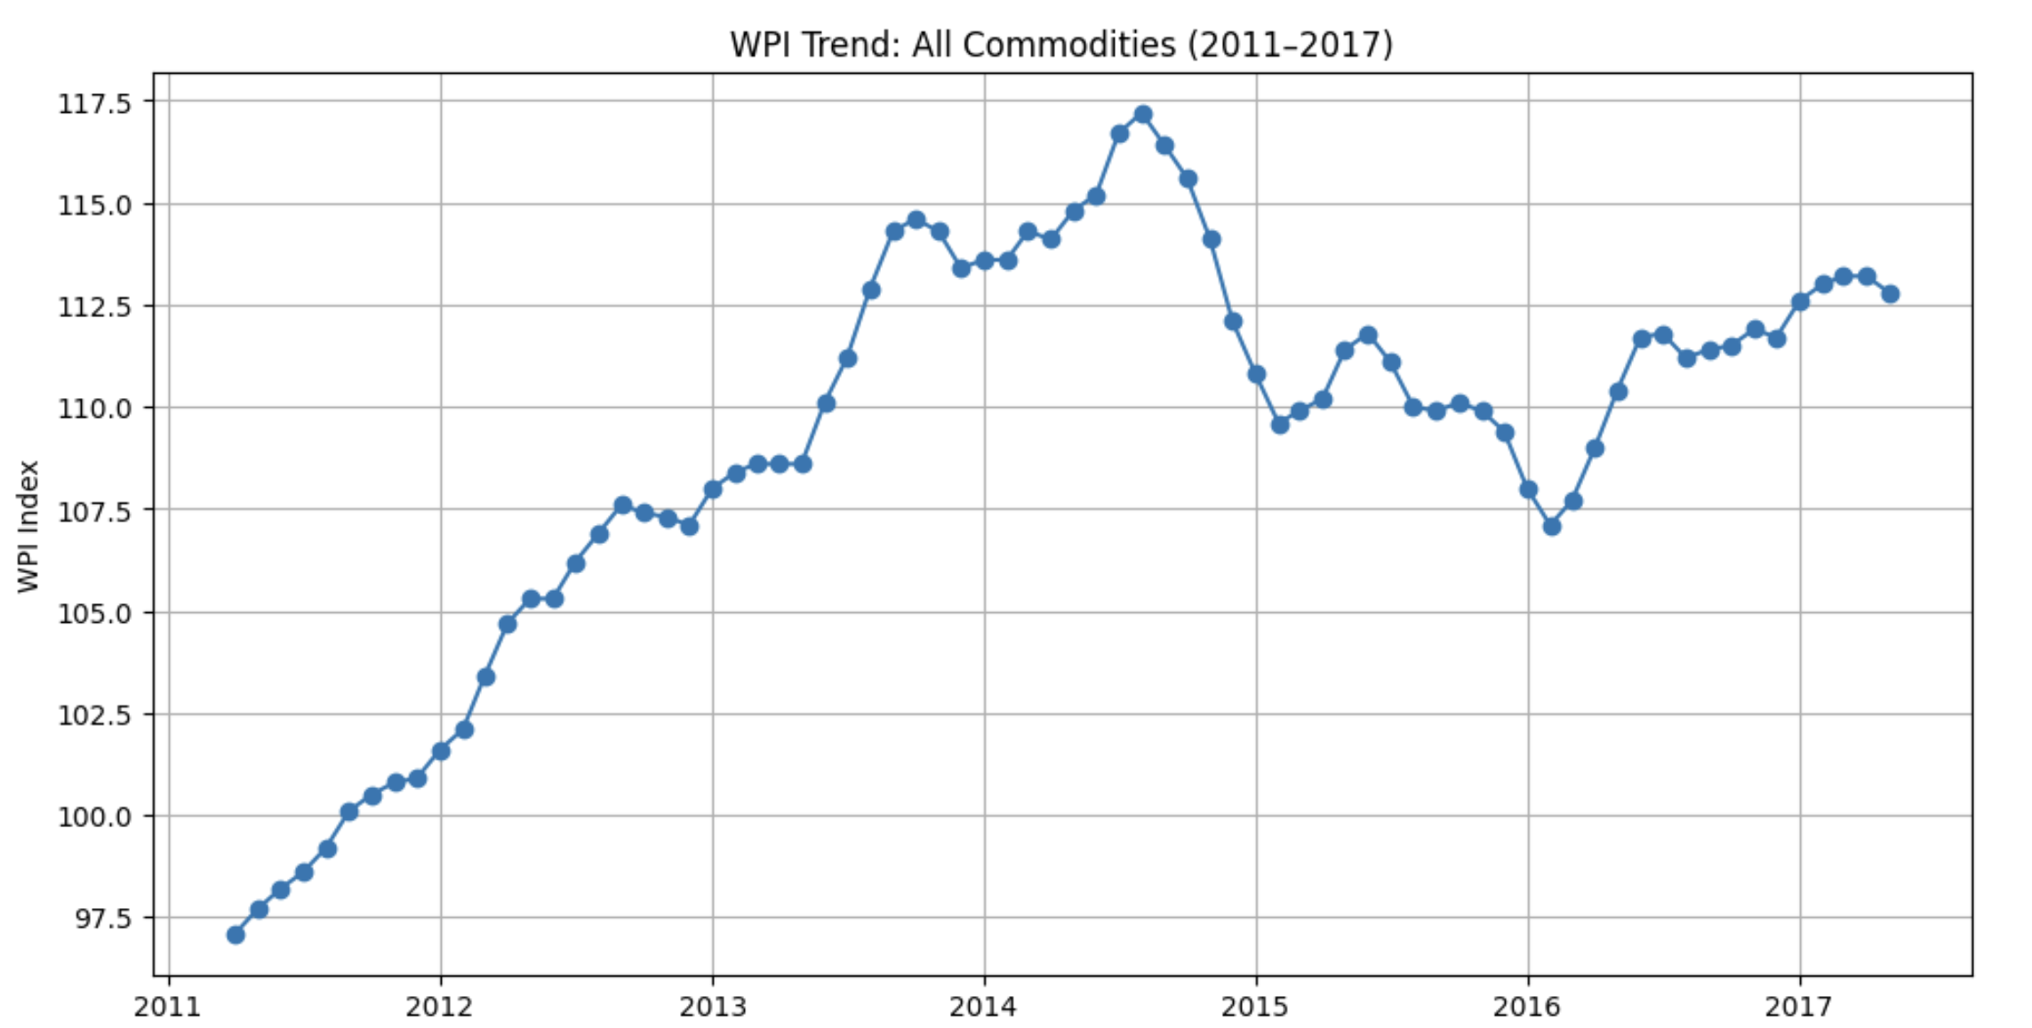

Slide 6
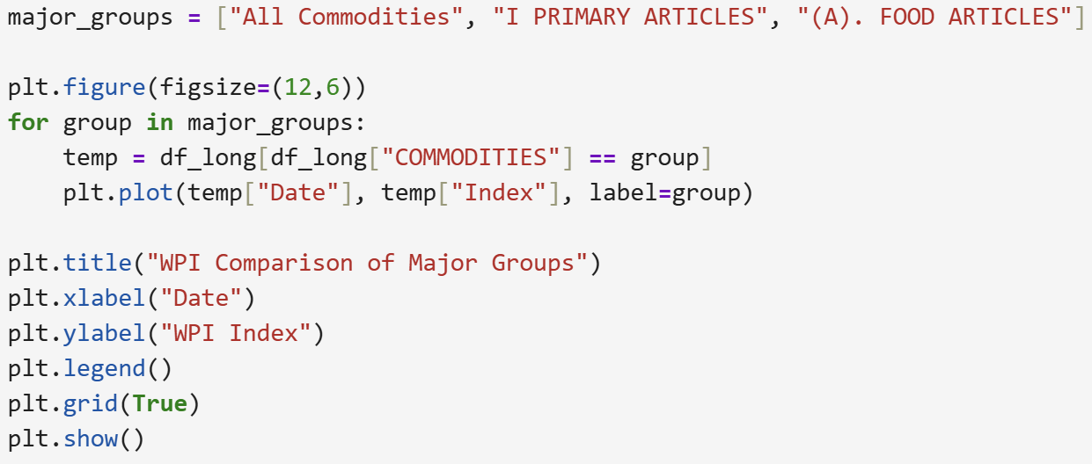
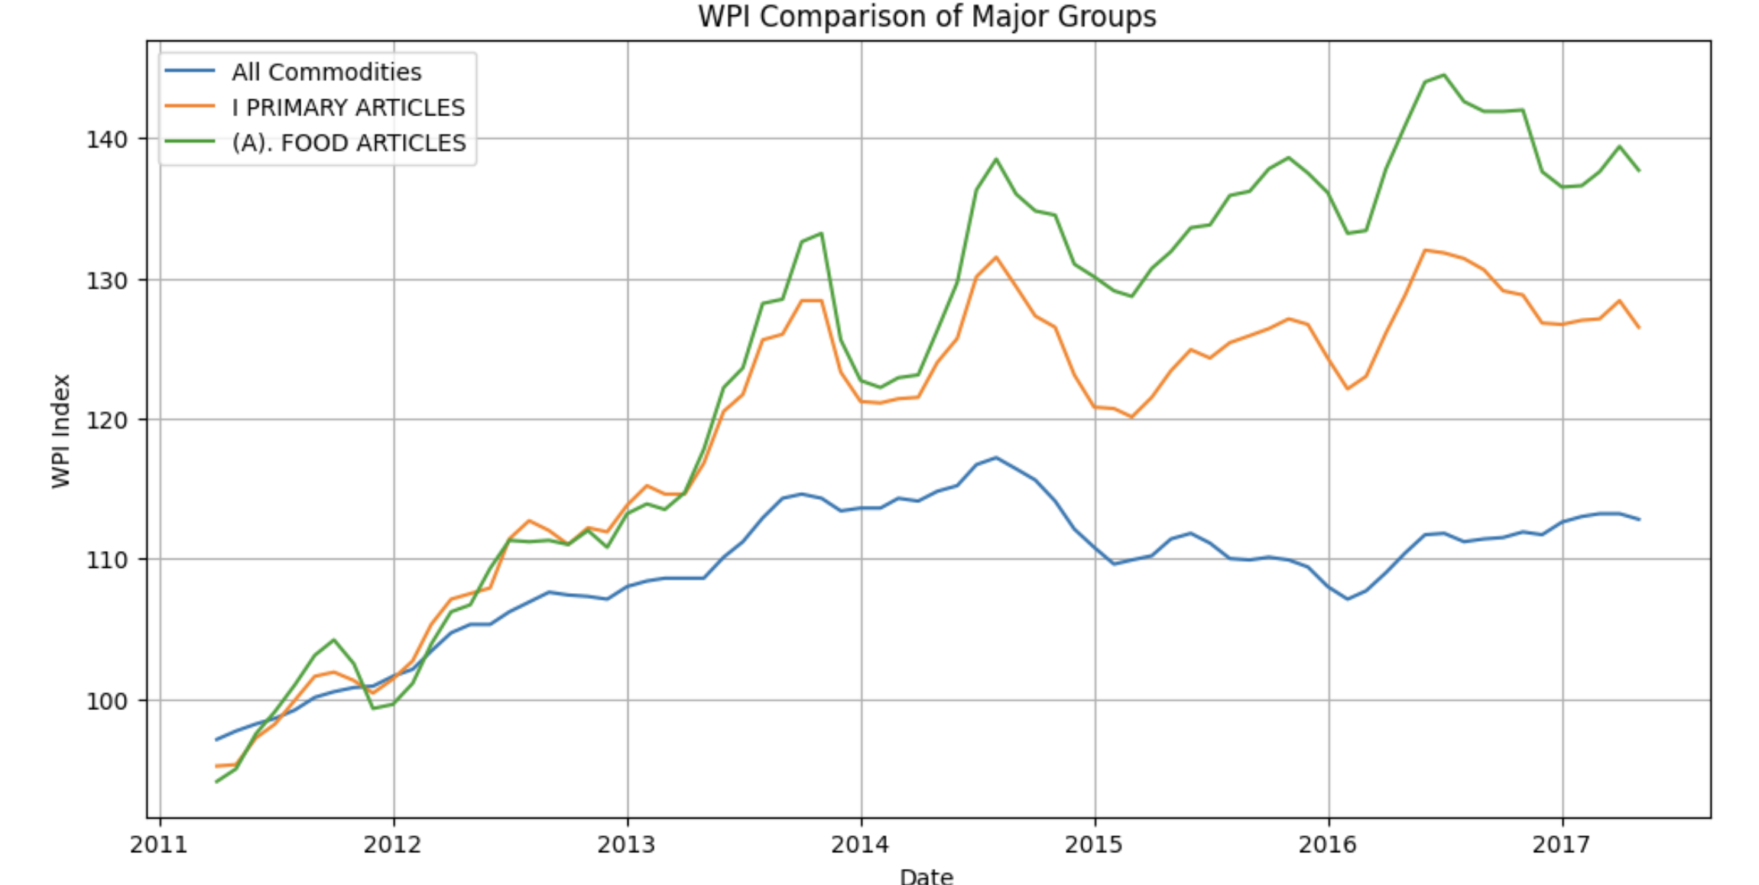

Slide 7
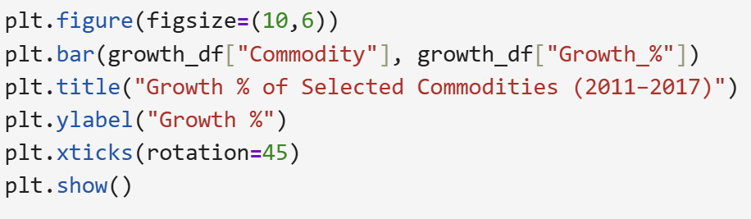
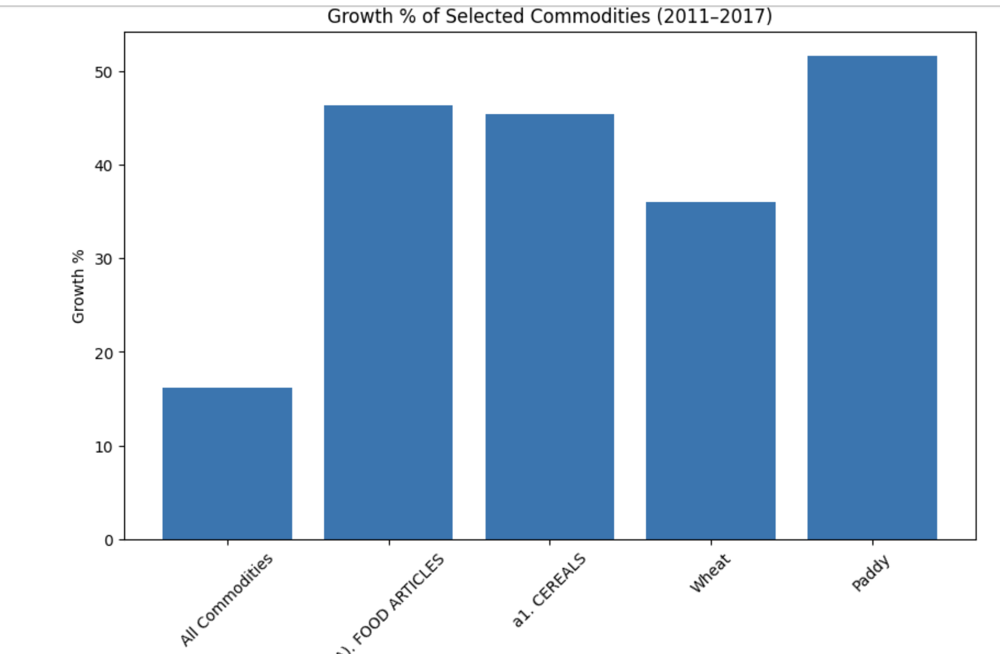

Slide 8
COMMODITIES | Weight | Apr-11 | May-11 | ... | Apr-17 | May-17
All Commodities | 100.00 | 97.1 | 97.7 | ... | 113.2 | 112.8
I PRIMARY ARTICLES | 22.61 | 95.2 | 95.3 | ... | 128.4 | 126.5
(A). FOOD ARTICLES | 15.25 | 94.1 | 95.0 | ... | 139.4 | 137.7
Wheat | 1.02 | 101.1 | 101.0 | ... | 141.0 | 137.5
Paddy | 1.43 | 97.5 | 98.9 | ... | 147.6 | 147.9

